Slide 1
數位系統實驗
Thu 9:00 pm – 12:00 pm
陳培殷
國立成功大學 資訊工程系

Slide 2
LAB - 01
陳培殷
國立成功大學 資訊工程系

Slide 3
Outline (10/07)
實驗器材和晶片的介紹
NAND gate驗證
Lab 01
Lab 02-1 (Optional)

Slide 4
Introduction of Solderless Breadboard
Solderless Bredboard is a convenient kit for lay outing circuits without any soldering work. It is very useful for circuit test and modification during practical training.
Components in lab can be reused with breadboard.
Normally, component’s pins are inserted into holes on breadboard. Every five holes are connected together by a brass stripe under plastic cover. One of holes is connected to component’s pin and the other holes are for circuit connection with jumpers.

Slide 5
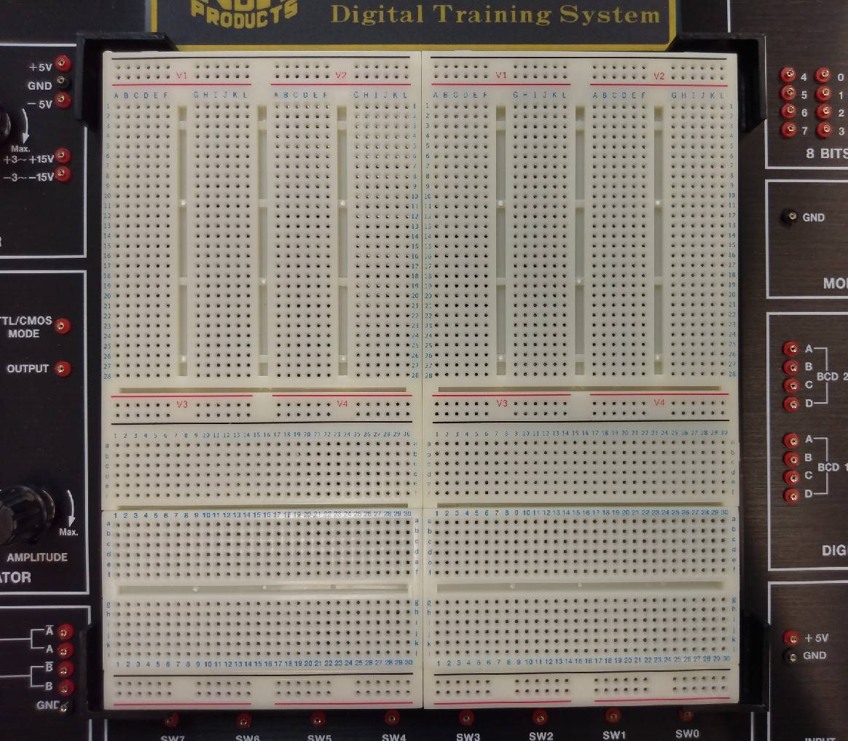
The Solderless Breadboard in CSIE NCKU
Top view of the breadboard

Slide 6
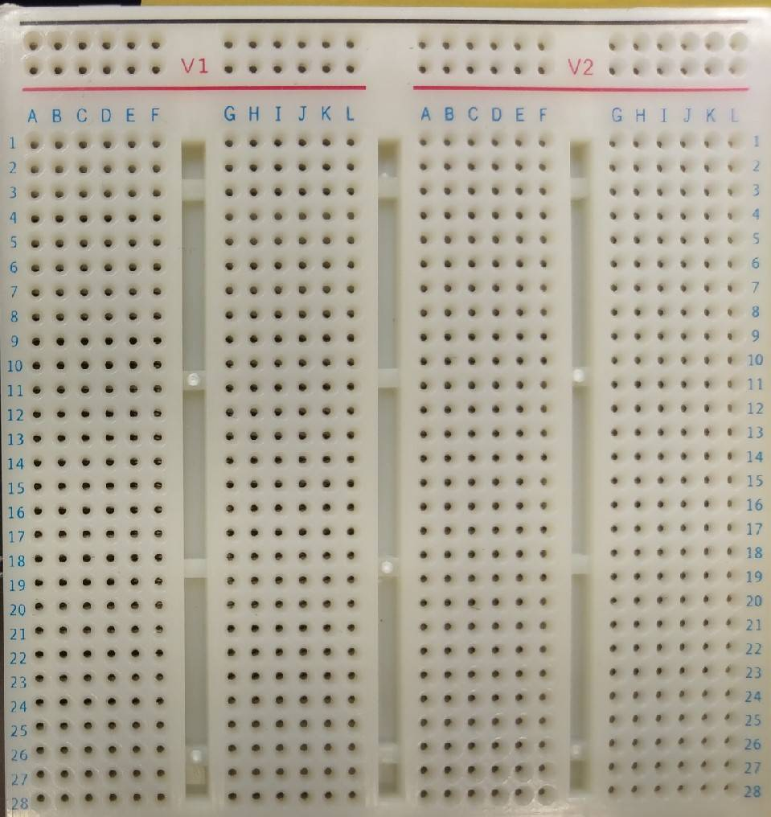
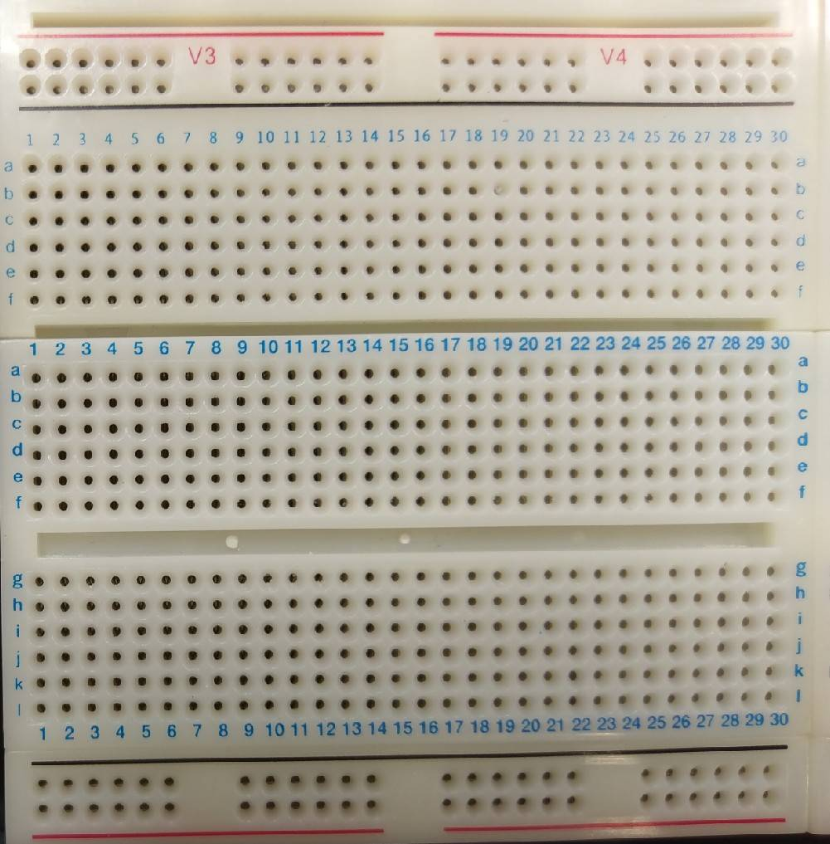
Various Breadboards
Different types of Breadboards

Slide 7
Top View of the Solderless Breadboard
: connected : disconected

Slide 8


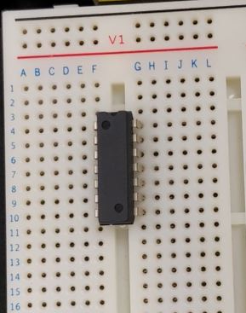
Connection of the Solderless Breadboard
5 V
e
f
e
+
-
5 V
+
-
VCC
GND
5 V
V1
f
e
f

Slide 9
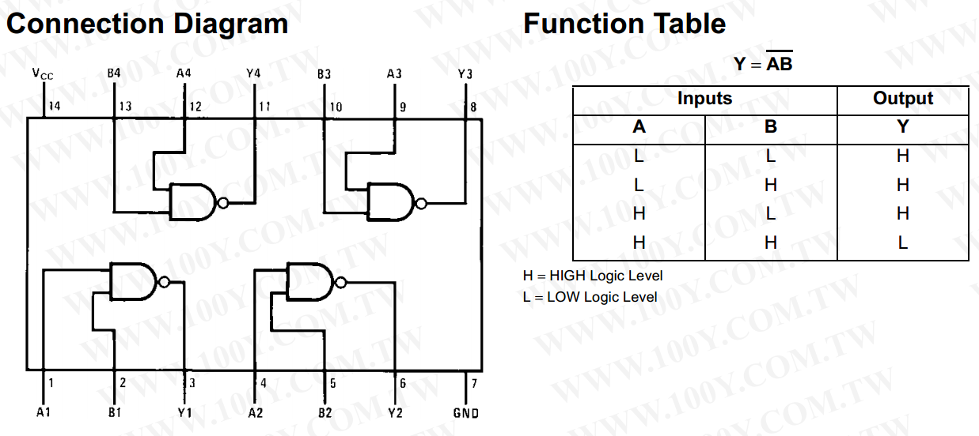
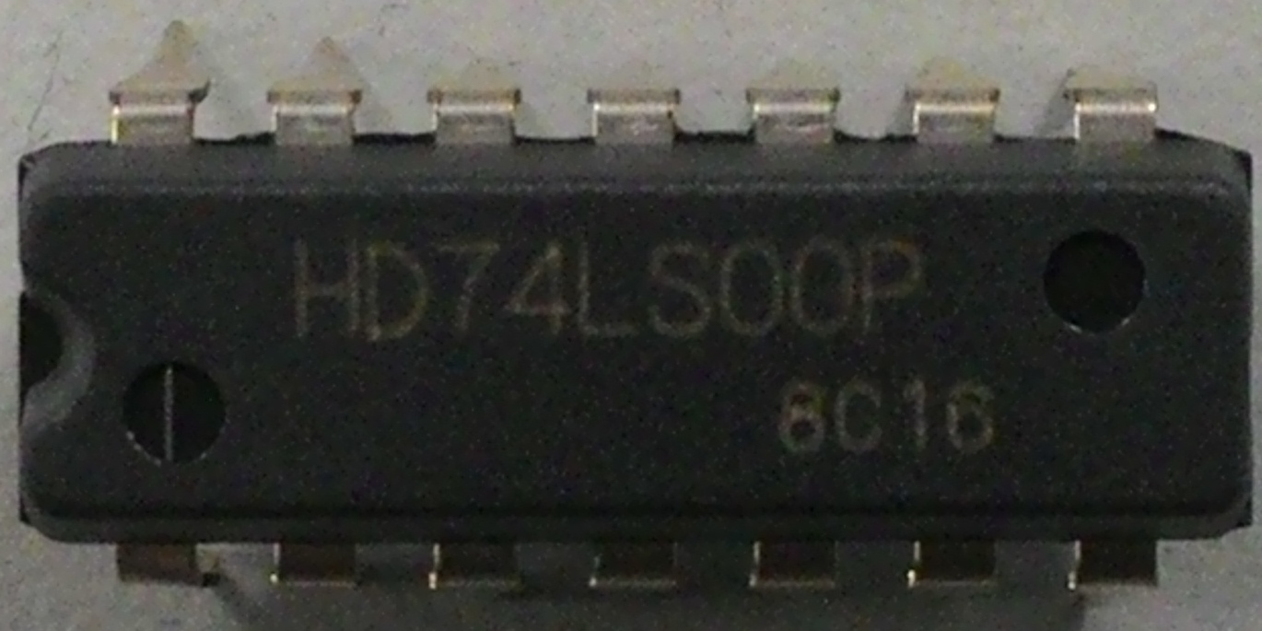
74LS00 (1/3)
NAND gate
Not - AND
Vcc (5V)
10 9 8
1 2 3
ground

Slide 10
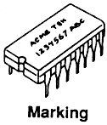
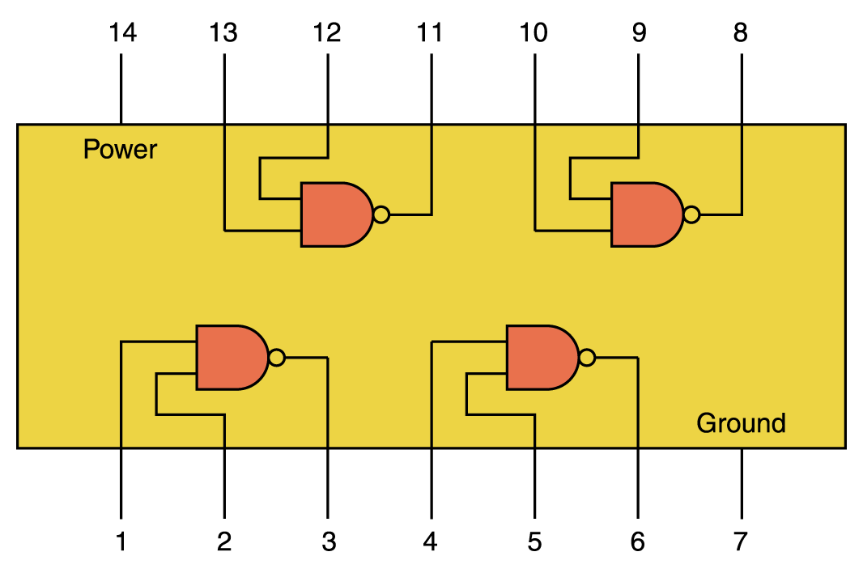
74LS00 (2/3)
ground
1
2
3
11
[2]
9
10
[3]
8
12
[1]
13
[1]
[3]
power
[2]
5 V

Slide 11
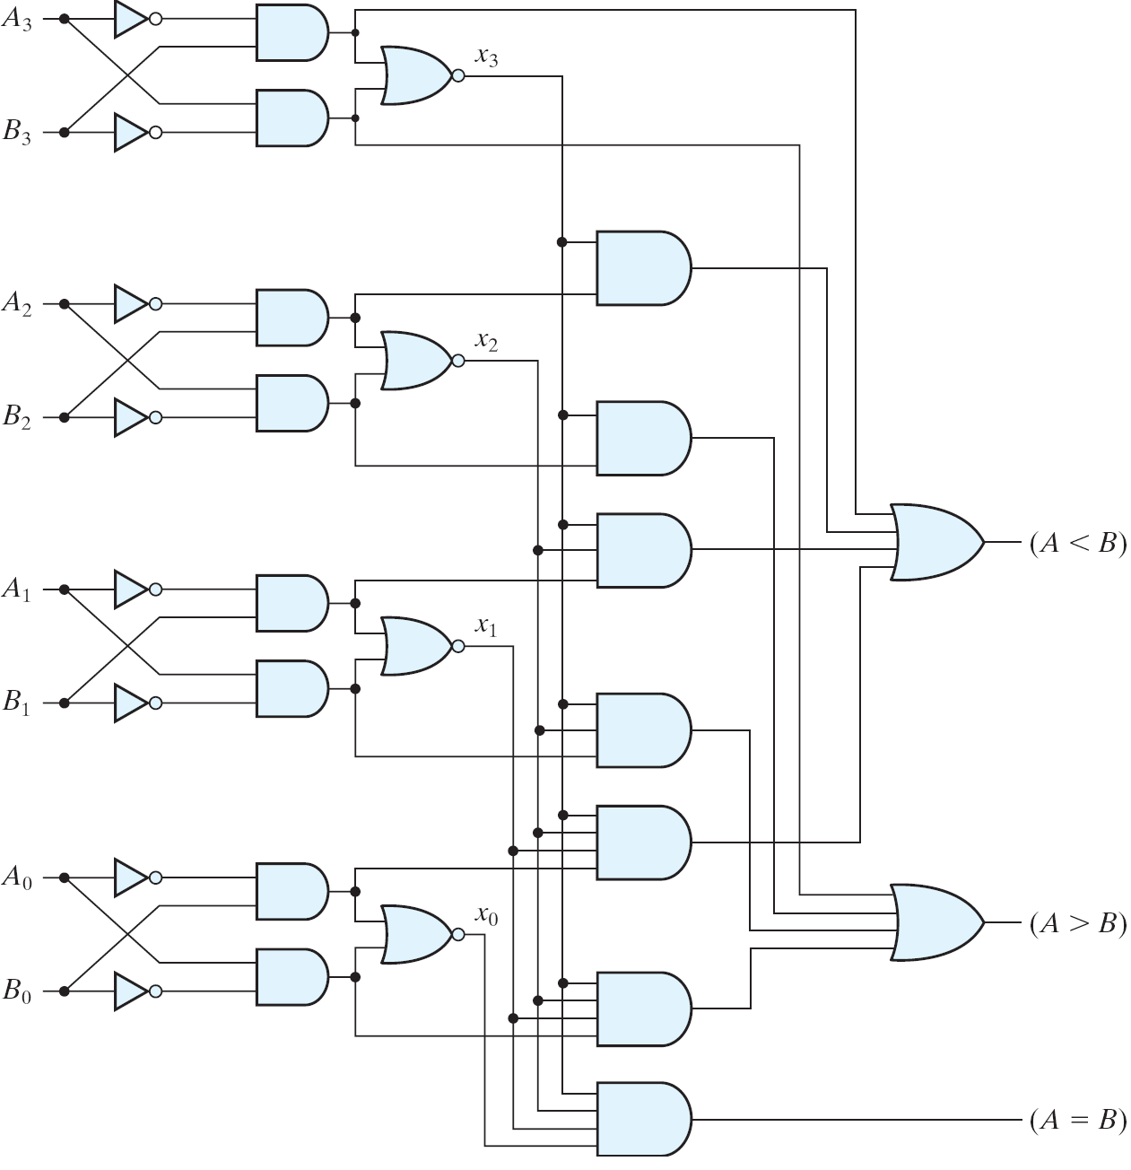
74LS00 (3/3)
1
2
[2]
[3]
8
12
[1]
13
[1]
[3]
[2]
Multiple chips (gates) are used to realize a specific circuit
A dedicated chip (ASIC, application specific integrated circuit)

Slide 12
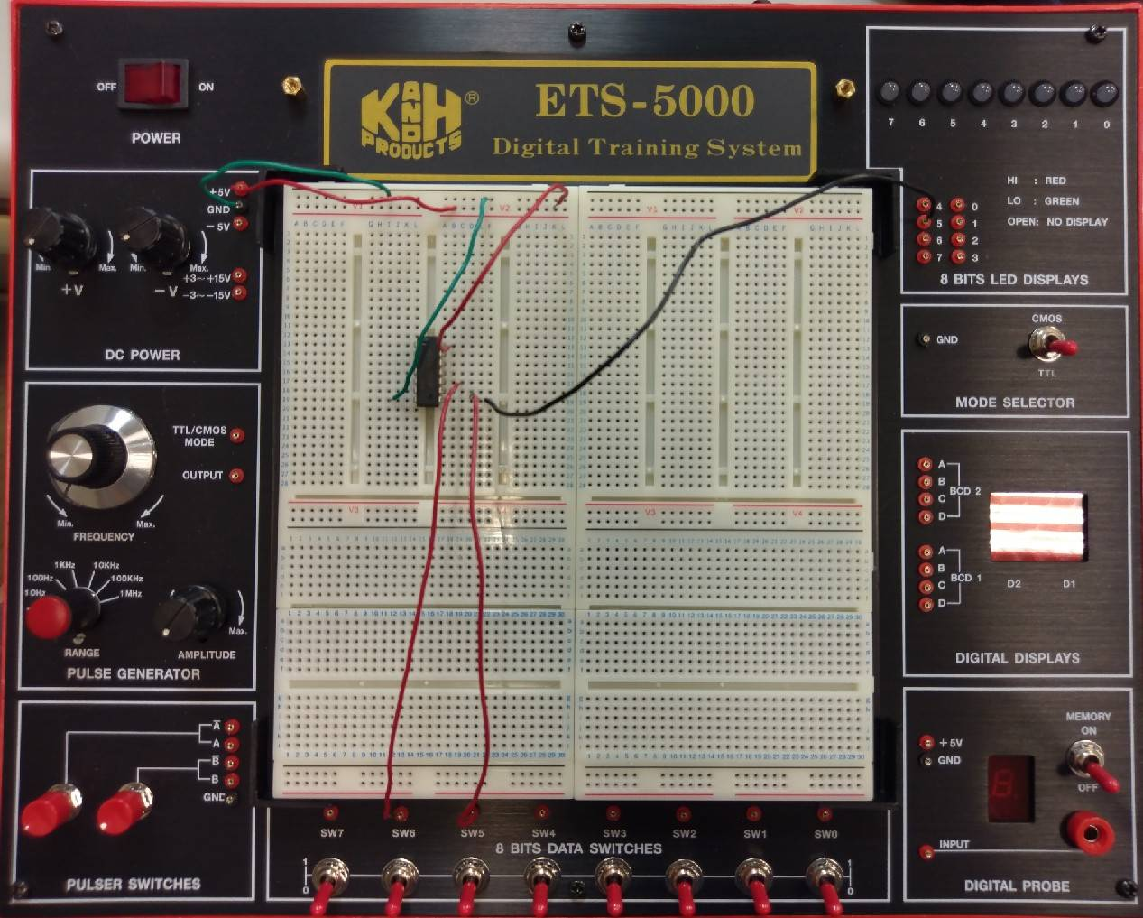
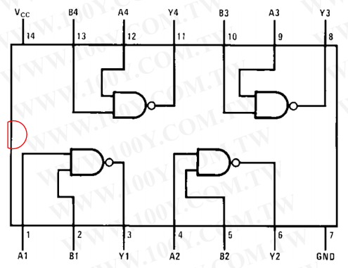
Example: Connection with 74LS00 Chip(1/7)
Board
output
power supply
TTL mode
Chip(NAND)
Wire connection & IC placement
input

Slide 13
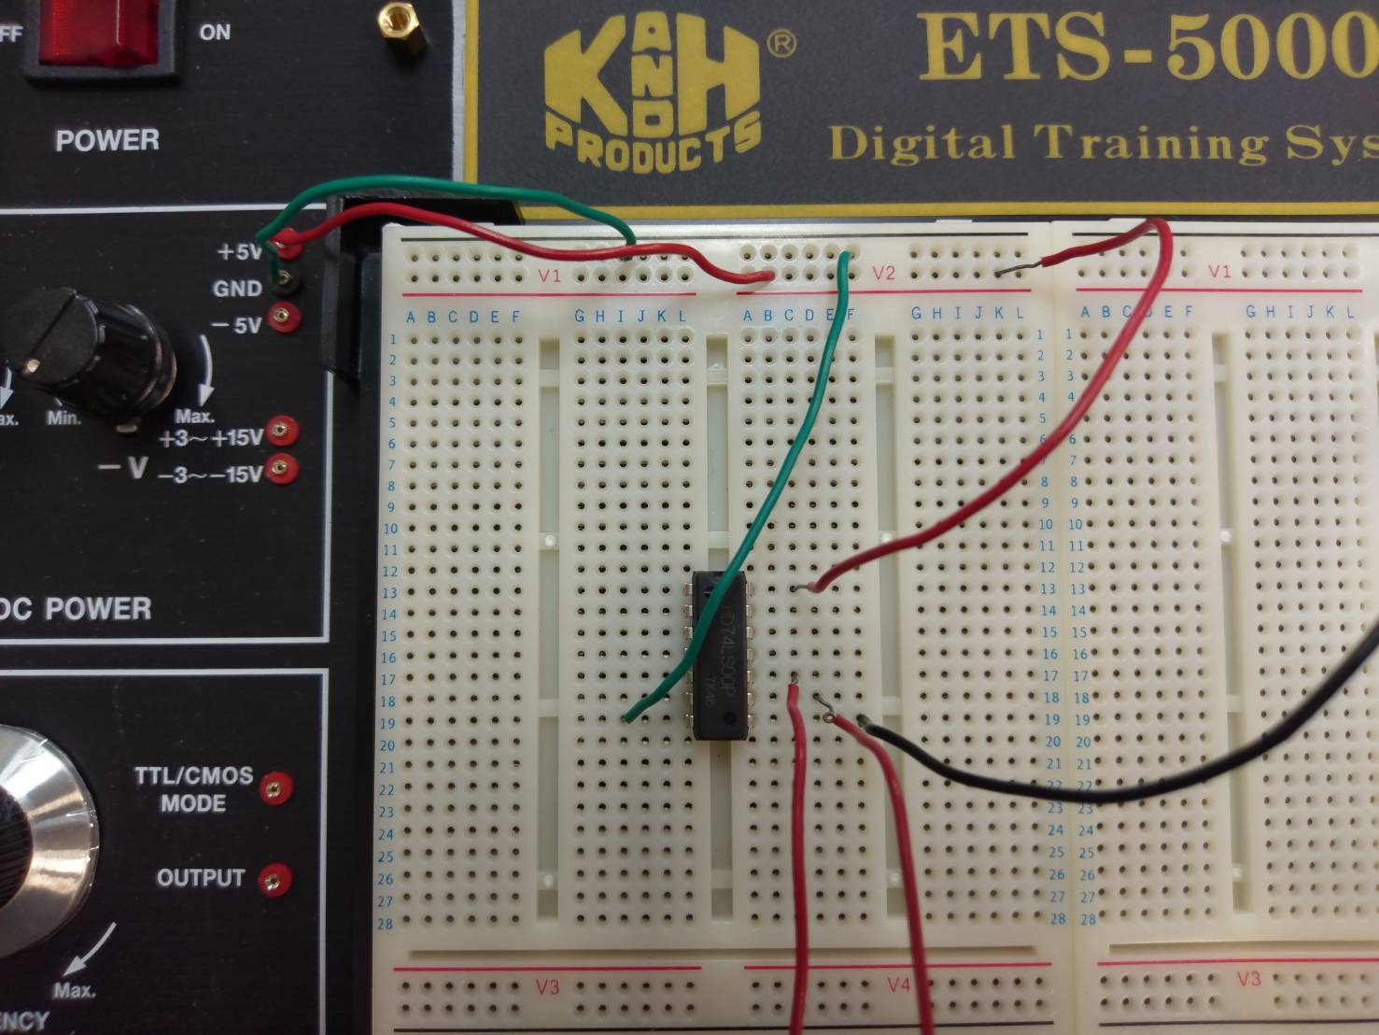
Example: Connection with 74LS00 Chip(2/7)
Board : wire connection
Chip(NAND)
Vcc (5V)
ground

Slide 14
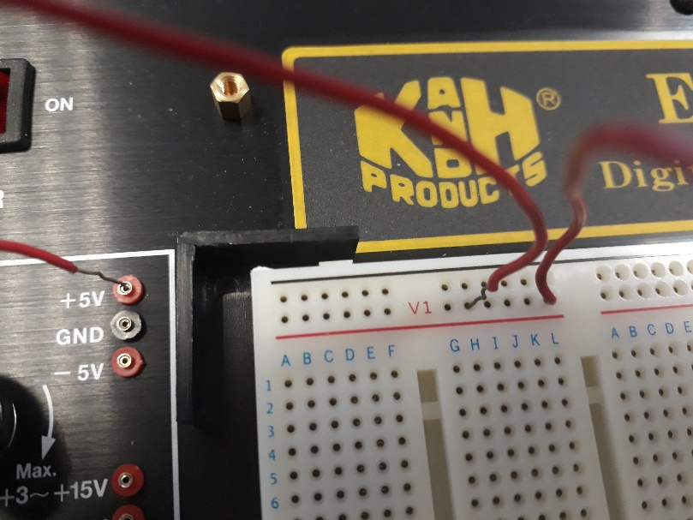
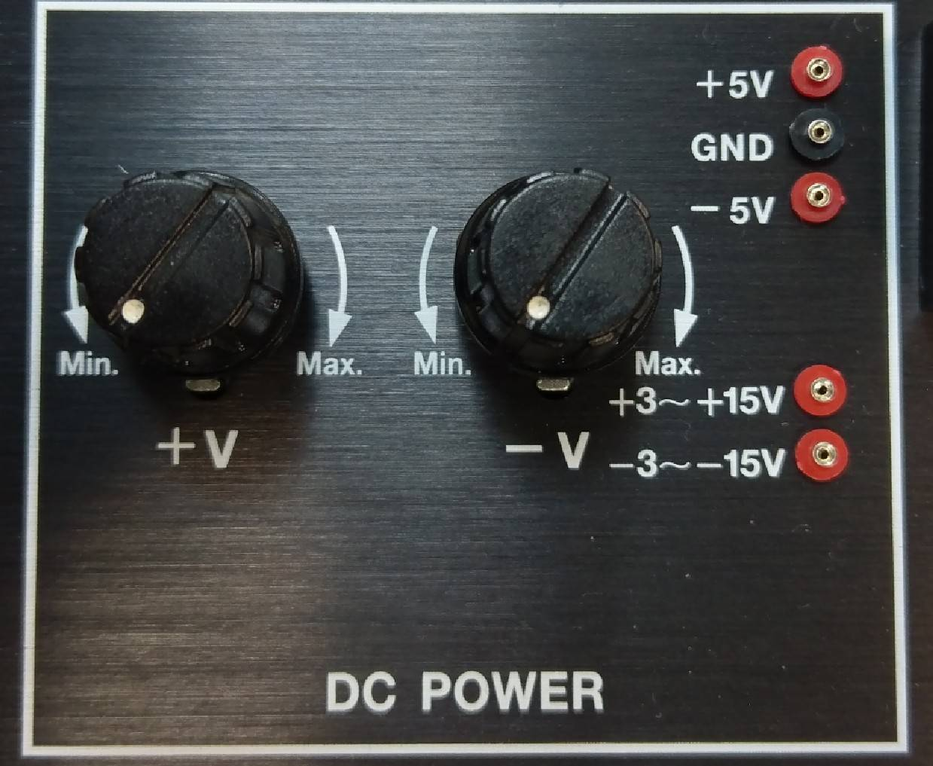
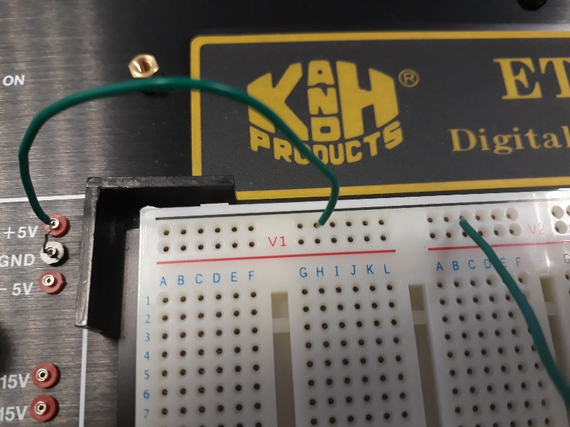
Example: Connection with 74LS00 Chip(3/7)
VCC
Power supply
GND

Slide 15
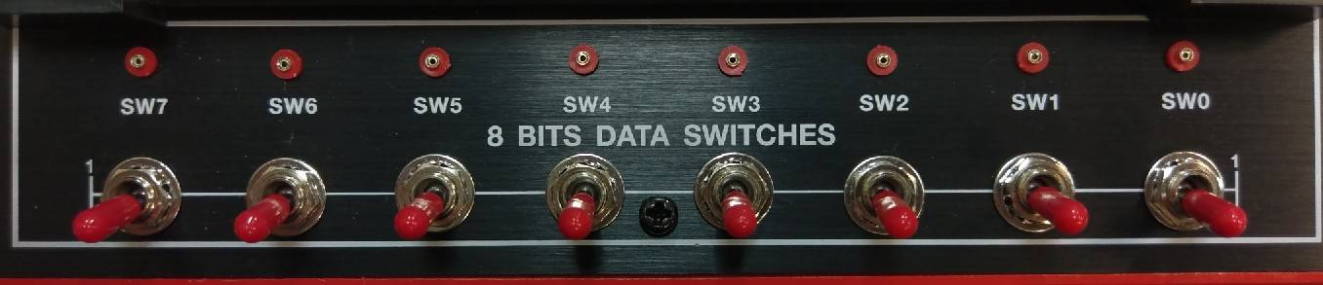
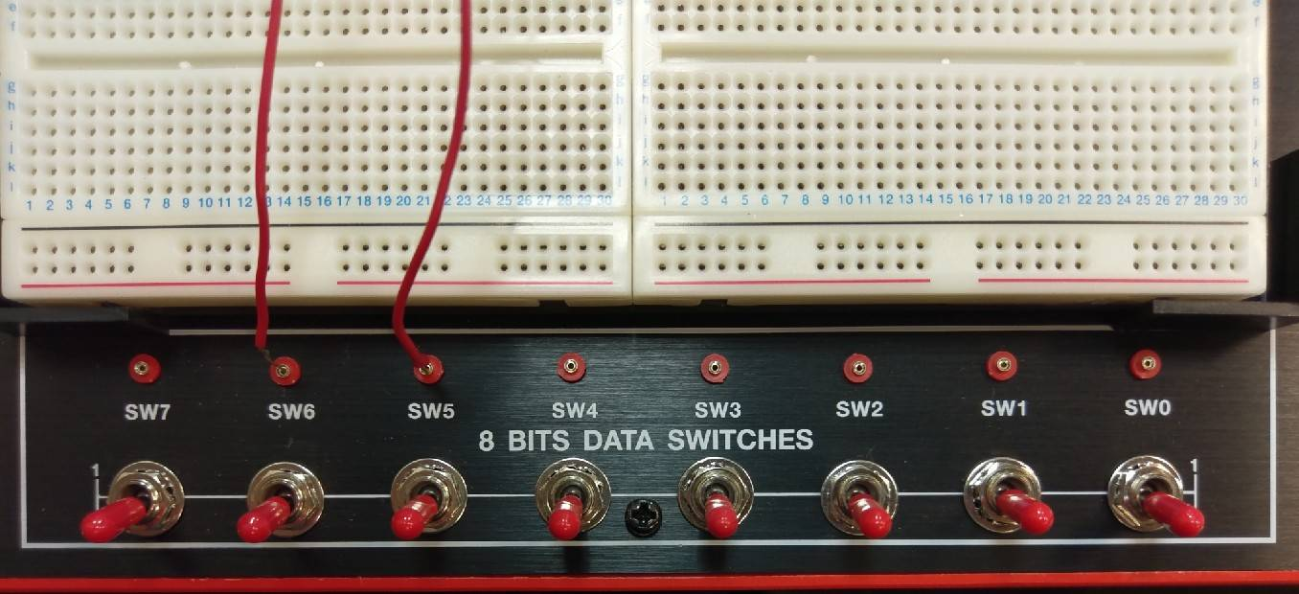
Example: Connection with 74LS00 Chip(4/7)
Signal input

Slide 16
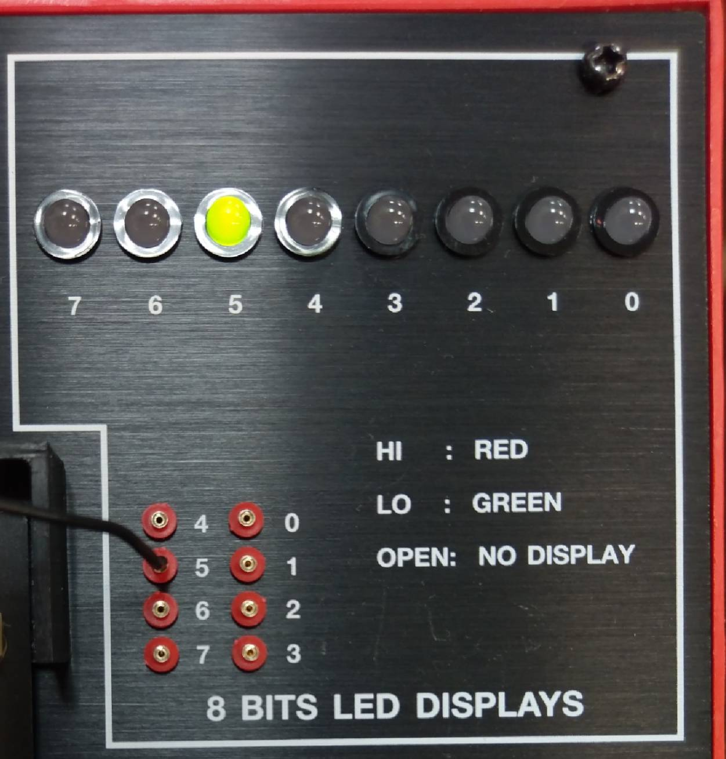
Example: Connection with 74LS00 Chip(5/7)
Signal output

Slide 17
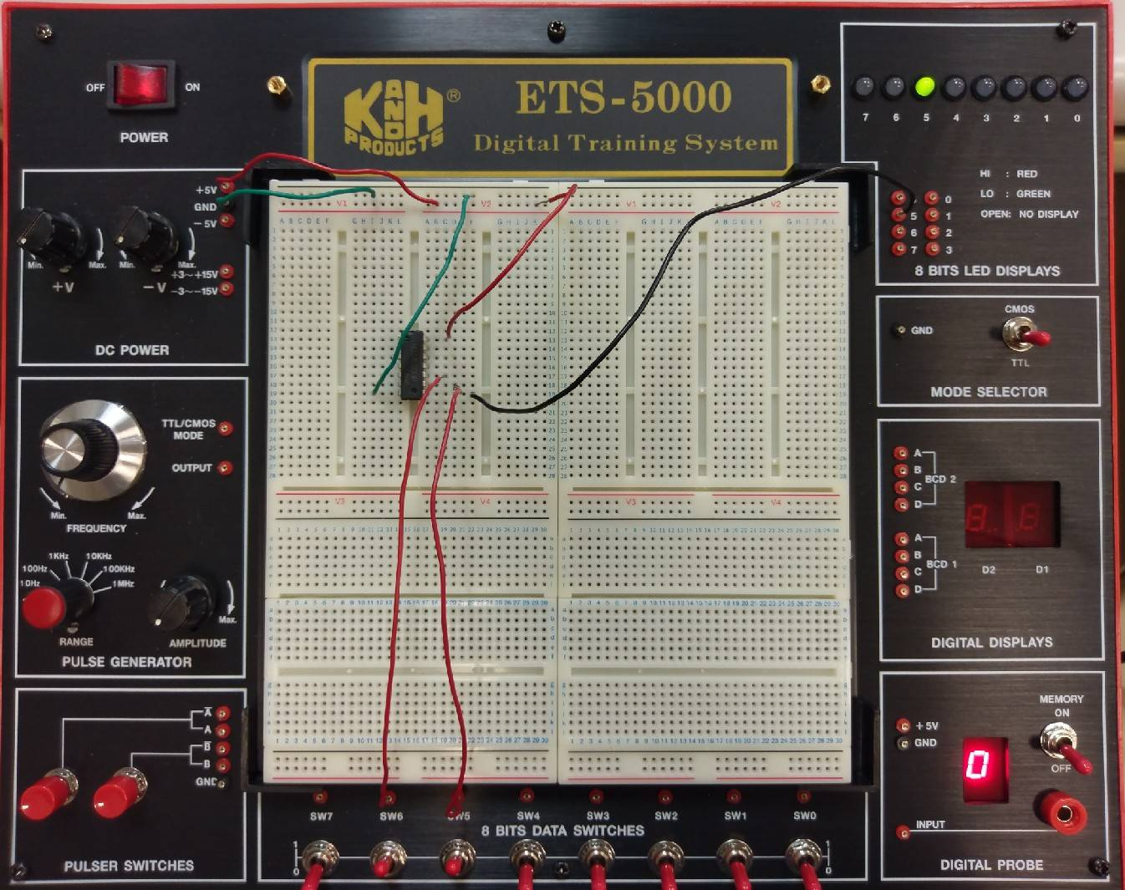
Example: Connection with 74LS00 Chip(6/7)
Input 11
Output 0
Y
74LS00 truth table
Input |  | Output
A | B | Y
0 | 0 | 1
1 | 0 | 1
0 | 1 | 1
1 | 1 | 0
A
B

Slide 18
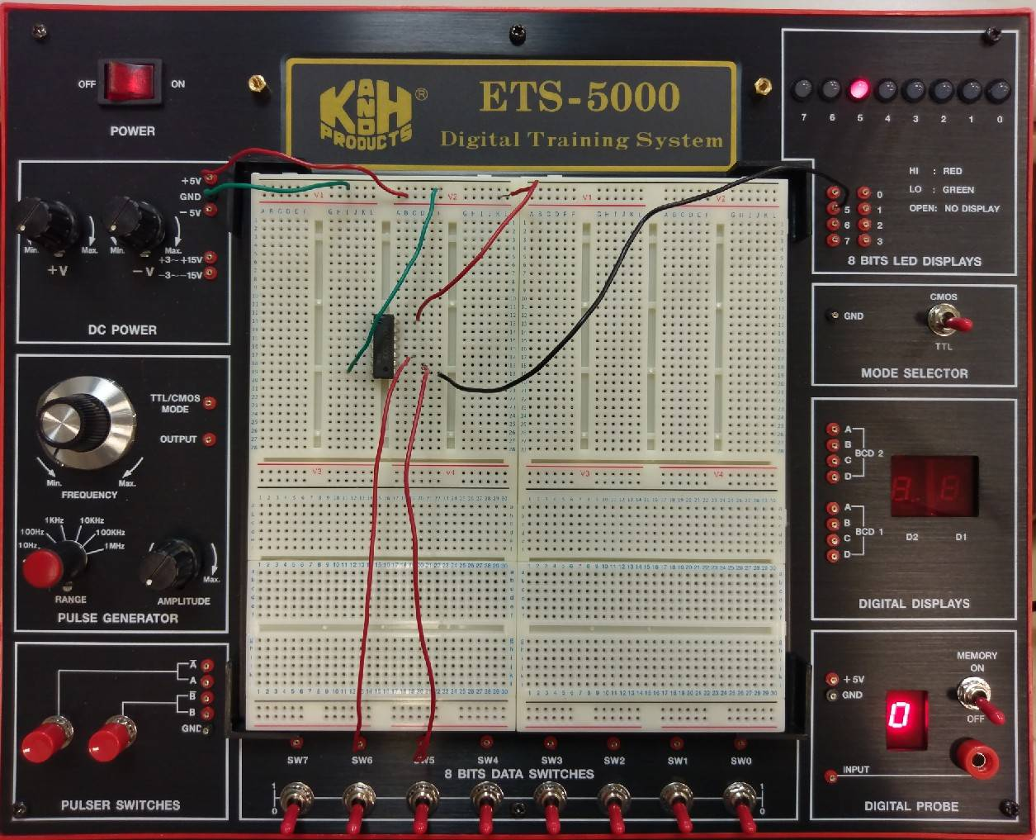
Example: Connection with 74LS00 Chip(7/7)
Input 00
Output 1
Y
74LS00 truth table
Input |  | Output
A | B | Y
0 | 0 | 1
1 | 0 | 1
0 | 1 | 1
1 | 1 | 0
A
B

Slide 19
74LS00
NAND gate

Slide 20
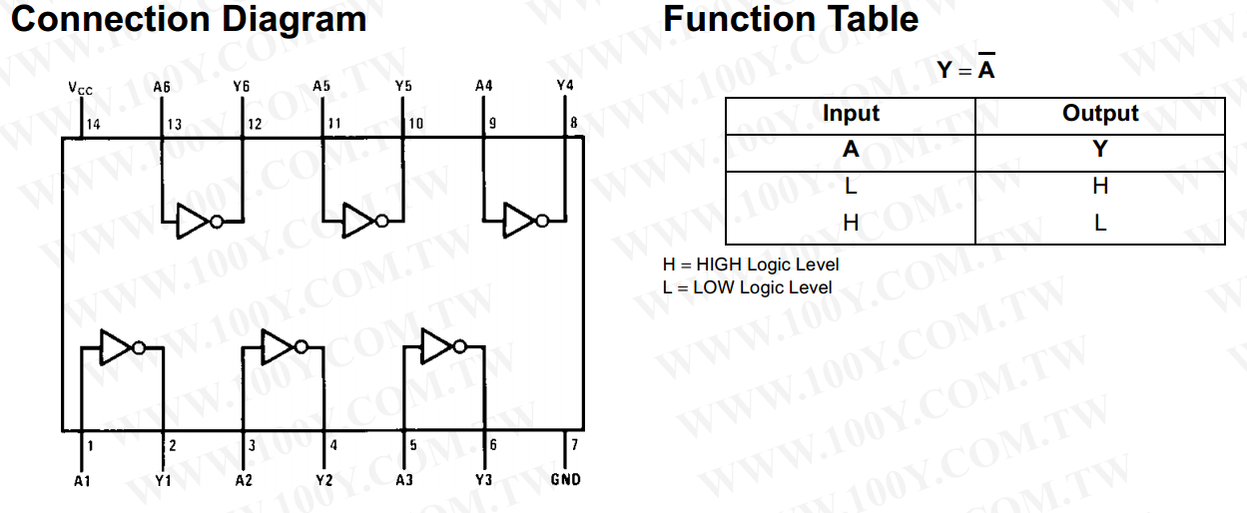
74LS04
NOT gate

Slide 21
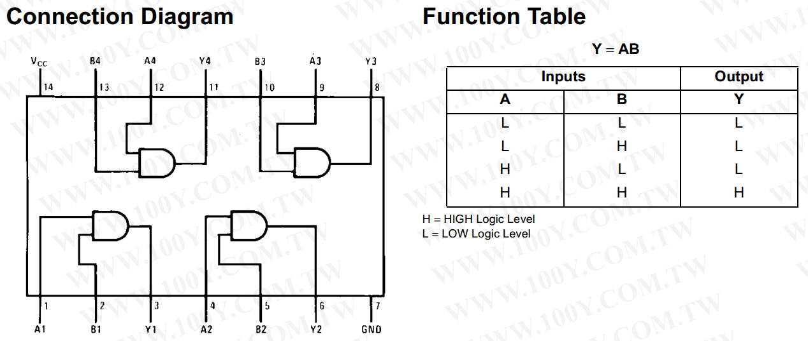
74LS08
AND gate

Slide 22
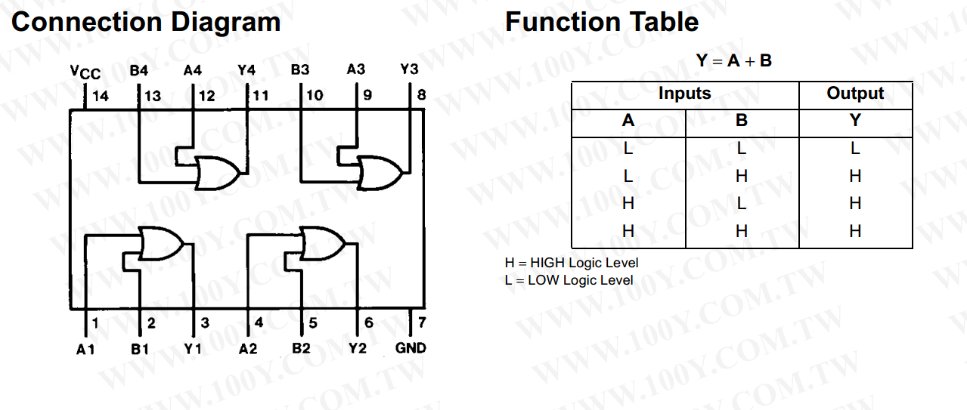
74LS32
OR gate

Slide 23
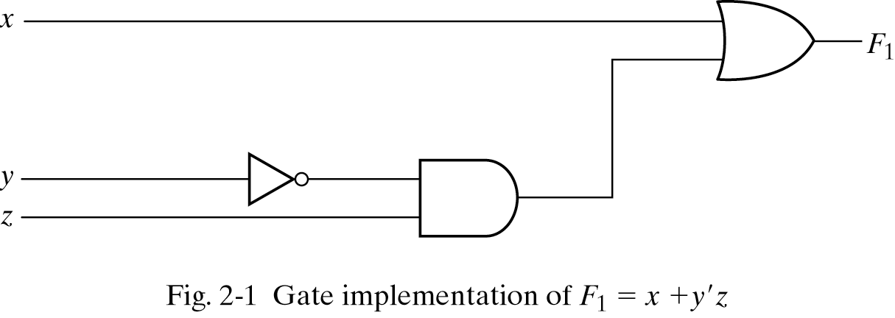
Three representations for a circuit
1. Boolean Algebra
2. Truth Table
真值表
n input variables ➔ 2^{n} combinations
F₁=x+y’z
Inputs
3. Circuit Diagram

Slide 24
Equipment
Names | Amount
Solerless Breadboard | ×1
74LS00 | ×1
74LS04 | ×1
74LS08 | ×1
74LS32 | ×1

Slide 25
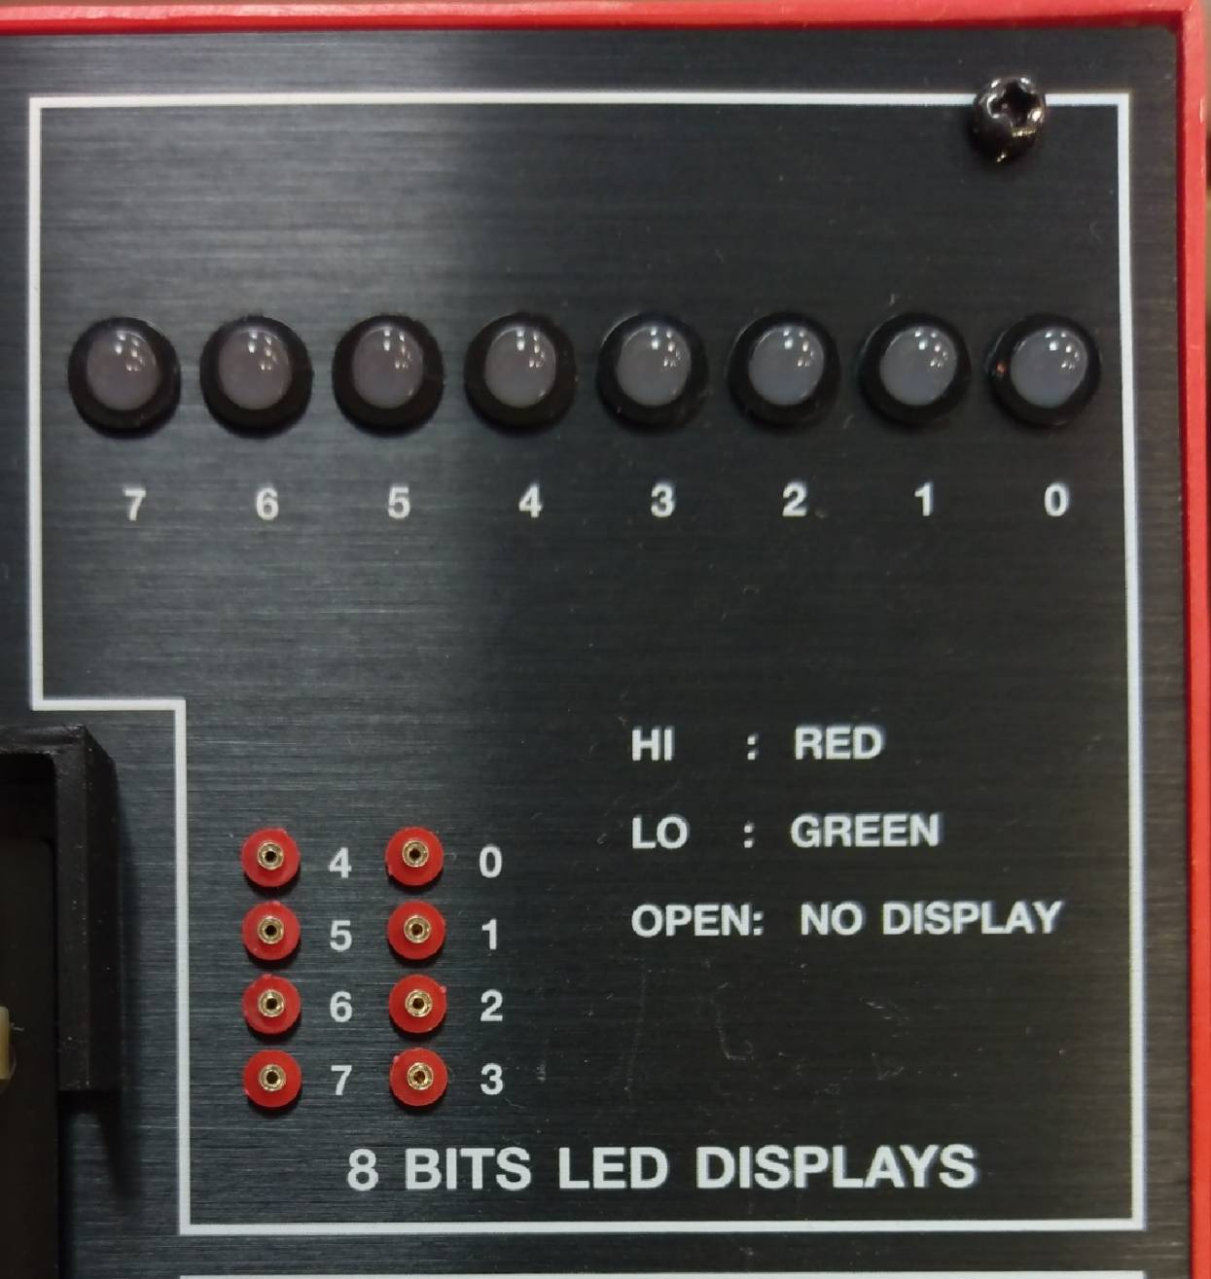
Lab notice
Input
Output

Slide 26
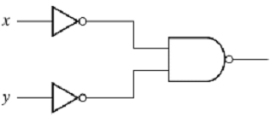
Lab 01
Please draw their Truth Tables and implement the circuit on the breadboard.
(a)
(b)
A
F
B

Slide 27
Lab 02-1 (Optional)
Please draw their Truth Tables and implement the circuits with breadboard.
F₁(A, B) = (A + B)’(A’ + B’)
F₂(A, B) = A’+ AB
Notes:
錯誤：此時不需化簡(已修正)

